Slide 1

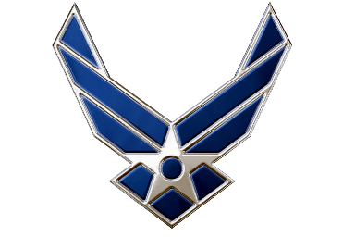

Combat Dining-In
Air Force ROTC Detachment 842
The University of Texas at San Antonio

Slide 2


Overview
Main Event Information
Schedule
Locations
UOD
Required/Optional Items
Rules of the Mess
Grog
Flight Table Decorations
Food Menu
Questions
Air Force ROTC Detachment 842 • We Build Exceptional Officers • The University of Texas at San Antonio

Slide 3
Main Event
Who: You!
What: Combat Dining-In
Where: JBSA-Lackland, AFB, San Antonio, TX @ Stillman Park
When: 23 November 2024 from 0645-1400
Why: This is Detachment 842s Fall Morale Event, with it’s purpose being to build esprit de corps within the cadet wing.
Air Force ROTC Detachment 842 • We Build Exceptional Officers • The University of Texas at San Antonio

Slide 4
Schedule
0645: Arrive to UTSA Brackenridge Lot 5 for Car-Pooling
0715: General Safety and Standards
0720: Departure from UTSA to JBSA-Lackland Parade Field
0800: Formation/Accountability at JBSA-Lackland Parade Field
0815: Parade Field/Static Display Heritage Run Begins
0930: Completion of Heritage Run
0945: Departure from Parade Field to Stillman Park
1000: Water War Safety, Rules and Expectations
1130: Conclude Water War
1145: FOD Walk
1215: Transition to Dining Area
1230: Begin Grog/Ceremony/Food
1400: Conclude Grog/Ceremony/Food
Air Force ROTC Detachment 842 • We Build Exceptional Officers • The University of Texas at San Antonio

Slide 5
Locations (Google Maps)
Brackenridge Ave Lot 5 at UTSA
https://maps.app.goo.gl/YqwFPpsa7PwufcWs5
Lackland Parade Field
https://maps.app.goo.gl/5juXvDg92EvQVLkt9
Stillman Park
https://maps.app.goo.gl/bMh3qktNDQUBdn4v5
Air Force ROTC Detachment 842 • We Build Exceptional Officers • The University of Texas at San Antonio

Slide 6
FOD WALK
A FOD Walk involves personnel walking in a designated area to search for and remove any foreign objects or debris (FOD).
After the water gun/balloon event, we will need to scour the field to collect and dispose of any related materials that are not natural (any non-vegetation).
How to FOD Walk
1. Line-up Shoulder-to-Shoulder across the Field (Each Squadron starting at both ends)
2. Walk Slowly and Methodically, Scanning the Ground
3. Pick-up and remove any FOD encountered
4. Dispose of items as necessary
Air Force ROTC Detachment 842 • We Build Exceptional Officers • The University of Texas at San Antonio

Slide 7
UOD
GMC Cadets:
PTGs
Flight Shirt
Black Watch
White Socks
Tennis Shoes
POC Cadets:
OCPs with Flight Shirt
Optional Second Set of Clothing
(Due to Water Activities)
Gray Shirt/Black Shorts
Detachment Shirt
Extra Socks/Athletic Shoes
Cold Weather Gear is Authorized
Air Force ROTC Detachment 842 • We Build Exceptional Officers • The University of Texas at San Antonio

Slide 8
Required Items
Required Items
Hand Sanitizer
Water Bottle
Snack
Sunscreen (Minimum 1 per flight)
First Aid Kit (Minimum 1 per flight)
Driver's License/Identification
Black Backpack
Towel
Optional Items
Water guns/water balloons (remain stored in cars until water fight)
There are filling-stations at Stillman Park, no need to show-up with water already inside your water guns.
Air Force ROTC Detachment 842 • We Build Exceptional Officers • The University of Texas at San Antonio

Slide 9
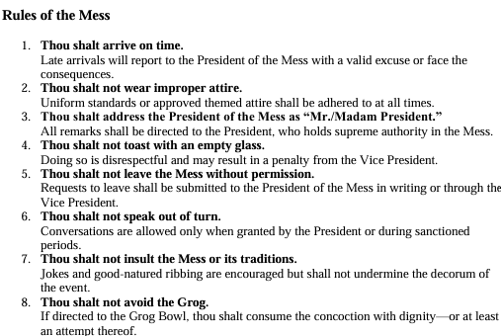
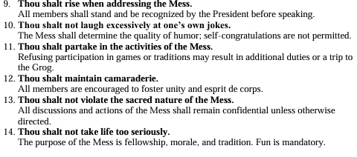
Rules of the Mess
Air Force ROTC Detachment 842 • We Build Exceptional Officers • The University of Texas at San Antonio

Slide 10
The Grog
Flight’s are Required to Bring the Following:
1 - Ingredient to be added to the Grog.
1 - Accompanying Rhyme to be stated when called to add ingredient.
There will be NO meat/fish, peanut, or alcohol products allowed!!
All ingredients are subject to approval.
Must not be solids: must be liquid/soluble.
Air Force ROTC Detachment 842 • We Build Exceptional Officers • The University of Texas at San Antonio

Slide 11
Flight Table Decorations
Representation Matters
Showcase your flight’s personality, history, or achievements.
Incorporate symbols, colors, or items that represent your flight.
Guidelines
Budget-Friendly: Keep decorations simple and cost-effective.
Portable & Safe: Ensure items are easy to set up and do not pose hazards.
Mess-Free: Avoid decorations that could damage the venue or require extensive cleanup.
Each flight is encouraged to bring decorations
for their table that reflect their unique identity.
Air Force ROTC Detachment 842 • We Build Exceptional Officers • The University of Texas at San Antonio

Slide 12
Food Menu
DET 842 OFFERINGS
x1 All-Beef Hamburger Patty w/Bun
Ketchup/Mustard
Cheese, Shredded Lettuce, Sliced Tomatoes
x1 All-Beef Hotdog w/Bun
Ketchup/Mustard
x1 Personal-sized Bag of Chips
(Variety-Pack)
Water and Gatorade to Drink
If any of these food options are not suitable for your consumption, you are welcome to bring something else for you to eat during the Grog Ceremony/Lunch portion of the Combat Dining In.
It will need to be pre-cooked, as you will not be authorized to utilize the grill.
Air Force ROTC Detachment 842 • We Build Exceptional Officers • The University of Texas at San Antonio

Slide 13
Questions? Please direct them to your Flight Commander.

Slide 14
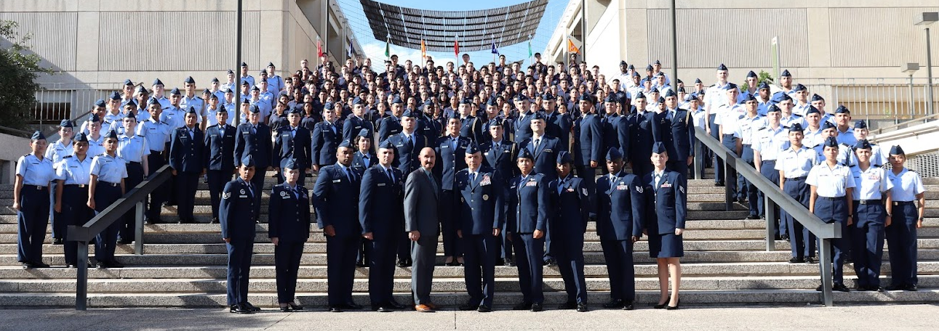
Air Force ROTC Detachment 842
The University of Texas at San Antonio
Det 842 – Best in Blue

